Slide 1

Integration with FortiGate

Slide 2


Working principle
The script is available on Vectra Github on this link.
Linux server where the script runs (cron job)
URI / token Vectra
IP / user / pwd
Prerequisites:
Python3, pyfortiapi==0.2.0, requests>=2.0
If FortiGate API should be contacted on another port than 443, then change python3.8/dist-packages/pyfortiapi.py with the desired port in the _init_ definition of the FortiGate class

Slide 3
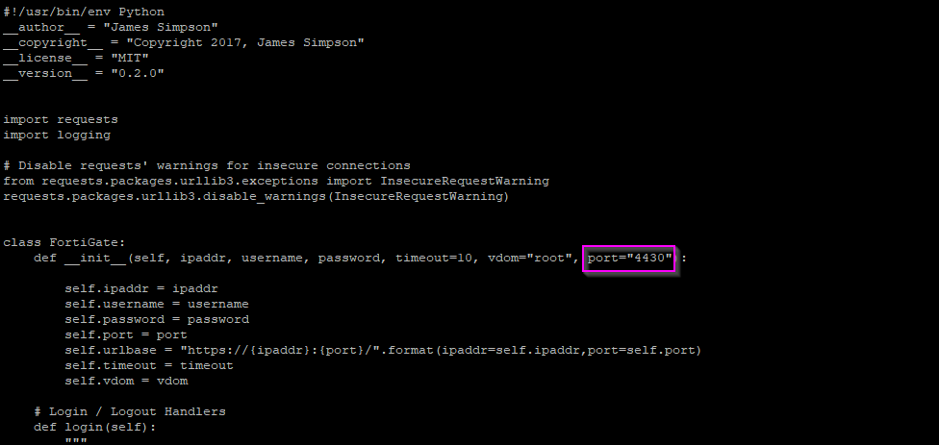
Working principle
If FortiGate API should be contacted on another port than 443, then change python3.8/dist-packages/pyfortiapi.py with the desired port in the _init_ definition of the FortiGate class.
Note: This FortiGate function is called in Vectra script in the main function “firewalls.append(pyfortiapi.FortiGate(auth['IP'], auth['USER'], auth['PASS’]))”
Ex: here the port 4430 is used to communicate with the FortiGate API

Slide 4
Example: block the destination IP of active detections with the specified tag (only for some C&C and Exfil detections)
1) python3 fortinet.py --block_detection_tag BLOCK
pyfortiapi.py
2) Get the list of DESTINATION IP involved in active detections with the tag BLOCK
3) Update the Fortinet group “Cognito Blocked Destinations” with the new IP to block
4) Add the tag “Blocked:manual” for the newly blocked IP
5) Remove the old manual tag “BLOCK” on all detections
Same principle for the --unblock_detection_tag tag

Slide 5
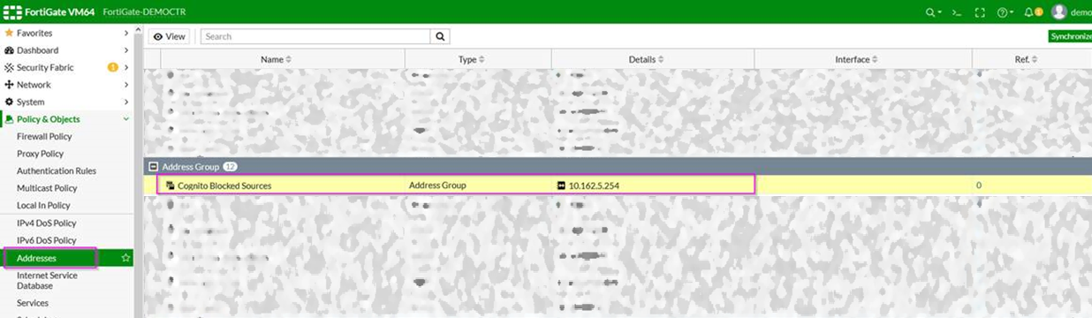
FortiGate results
Be sure to create or update your firewall security policies accordingly to utilize the groups.

Slide 6
Thank you

